Slide 1
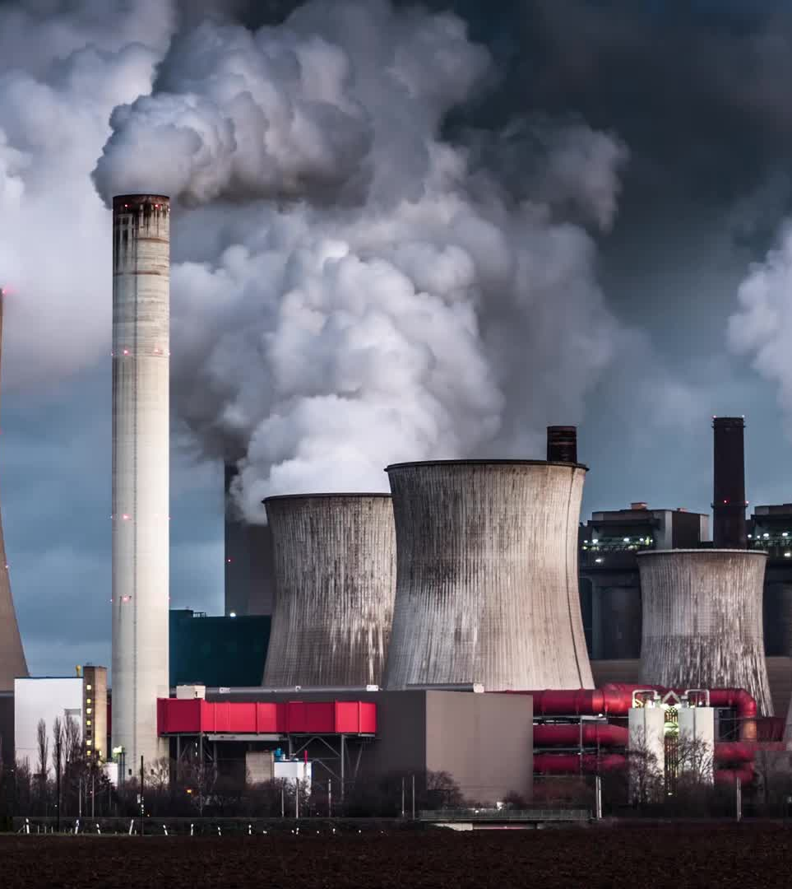
Examples of Challenges to Sustainability
Population growth
Energy use
Climate change
Land degradation
Habitat loss
Urbanisation
Pollution
Exploited oceans

Slide 2
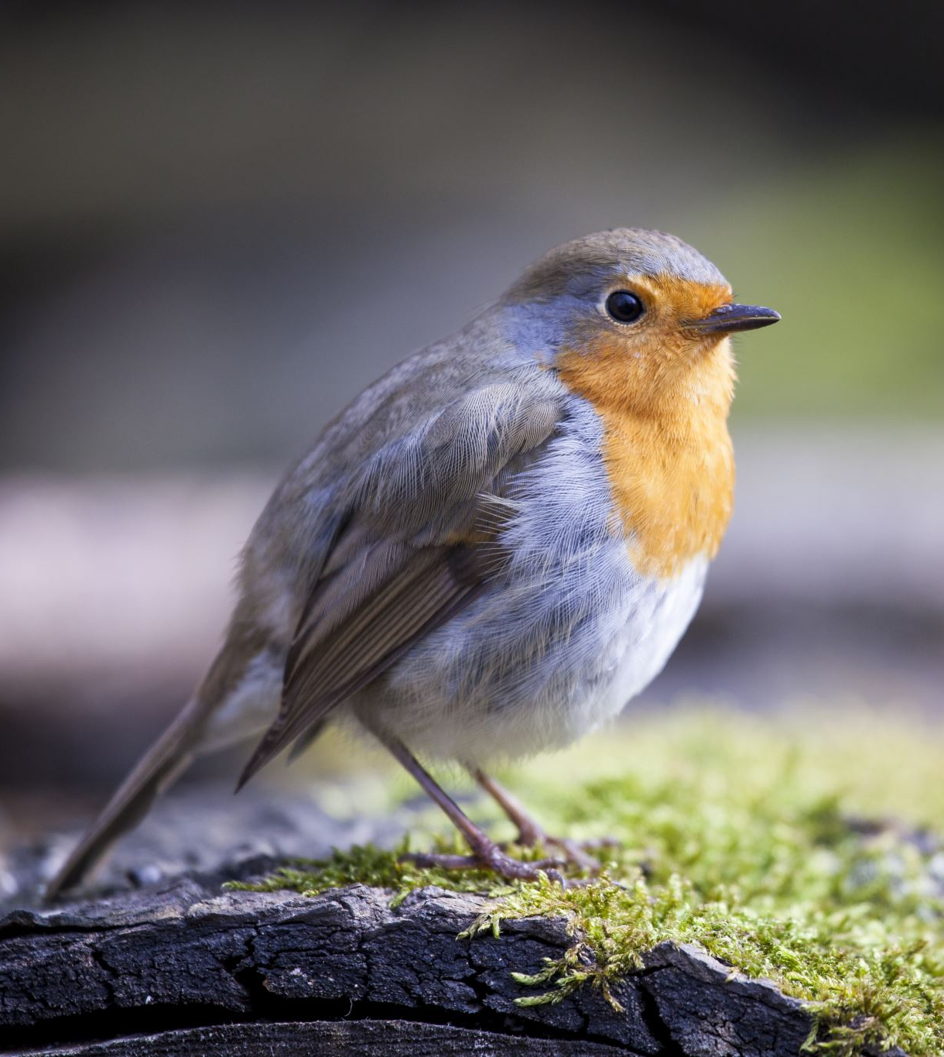
Biodiversity
The type, number and variety of living organisms within a given environment.

Slide 3
Anthropogenic Biomes
Biomes that are the result of sustained direct human interactions with ecosystems.

Slide 4
Contribute to the rate and extent of environmental change (land cover change)
world population growth
growing affluence (w_________)
advances in technology

Slide 5
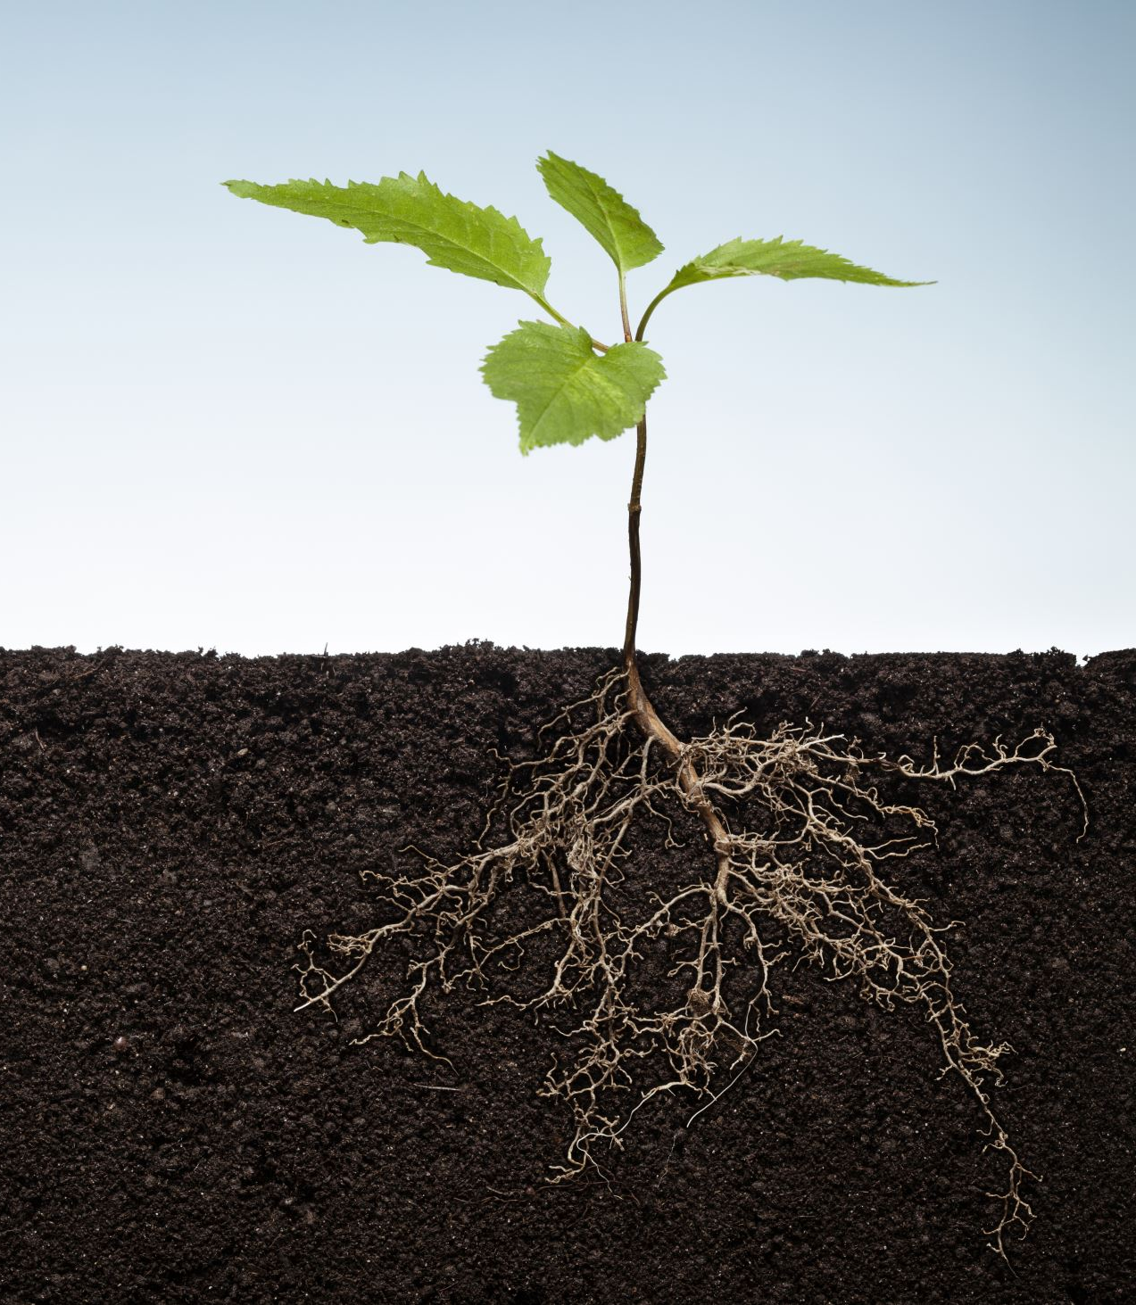
Environmental change
Definition:
Environmental change is any alteration to an environment that disturbs natural ecological processes
Some environmental changes have positive and/or beneficial outcomes for humans. On the other hand, environmental changes can also have negative and/or detrimental effects, such as soil erosion, water and air pollution or climate change.

Slide 6
BLAH – State what BLAH stands for
B
L
A
H

Slide 7

Ecosystem Services provided by the Environment
Humans have the ability to degrade (reduce; breakdown) the environment to such an extent that the ecosystem services on which we rely become threatened.

Slide 8
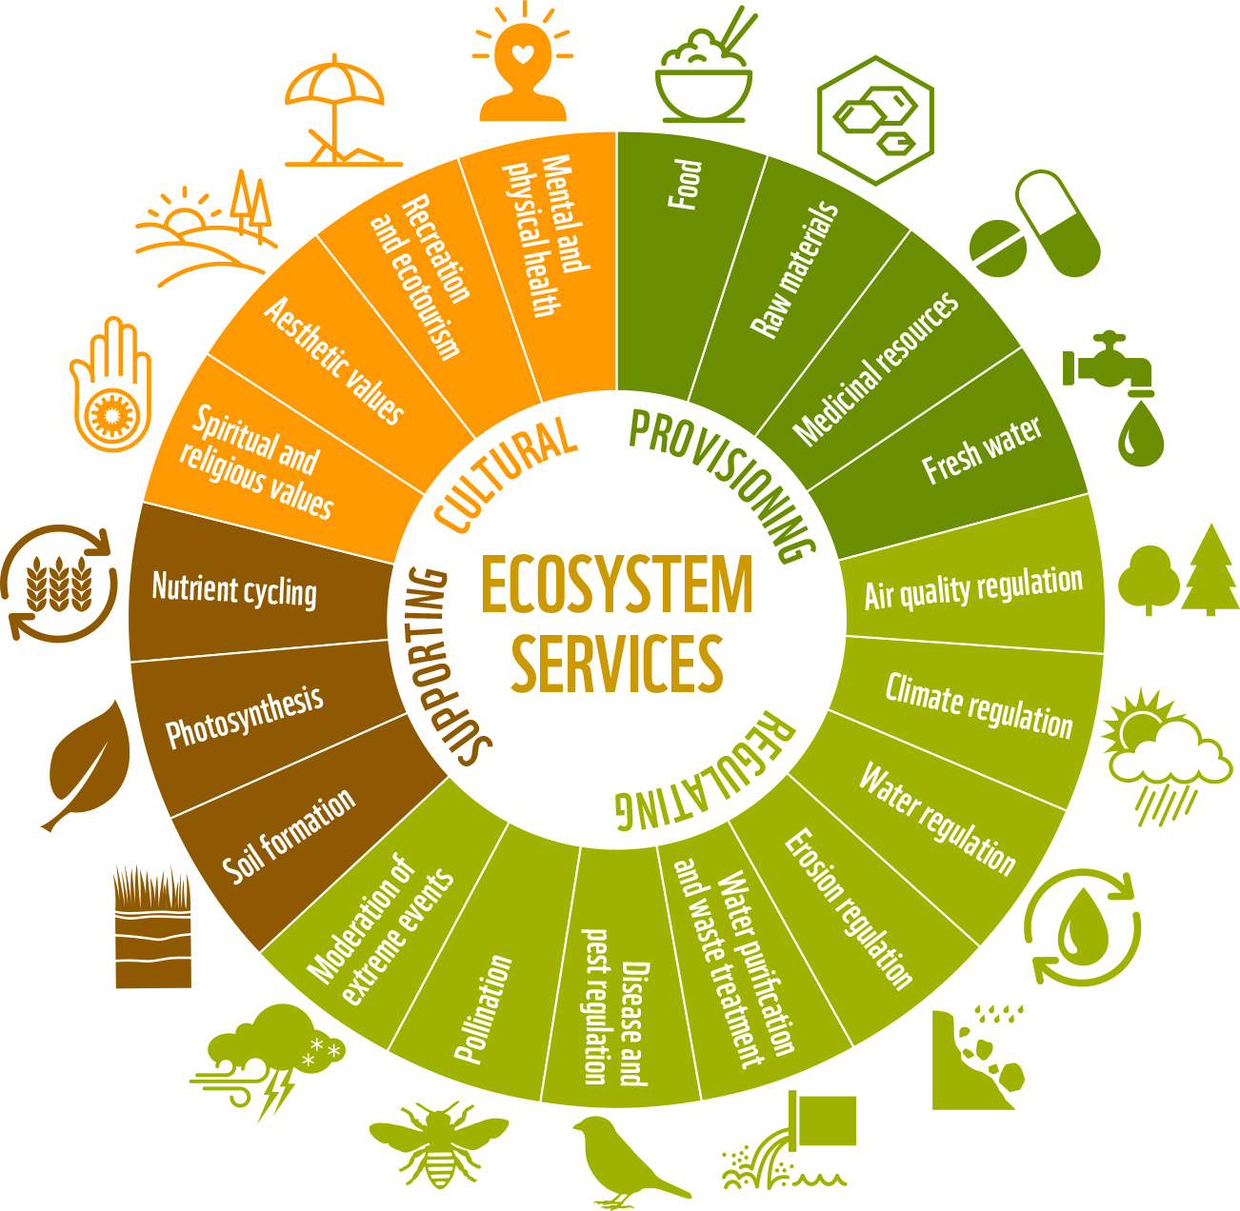

Slide 9
Dear Future Generations: Sorry.
https://www.youtube.com/watch?v=eRLJscAlk1M
This was uploaded in 2015; think about predictions made/what has happened since then (especially post-COVID-19).
Has been 160 652 comments have been posted about the YouTube video.
Use the think-pair-share strategy, starting with students individually writing a 50 word comment about what they heard and/or saw in the video.
Ask students to share their comments with a partner and then expand the discussion to include the whole class.
What is the concept of sustainability and consider the impact humans are having on the sustainability of the planet.

Slide 10

Your Task
In your own words, please write a definition of sustainability and provide some examples of some sustainability actions and/or strategies
e.g. banning single use plastic bags, banning plastic straws.

Slide 11

Sustainability
Meeting the needs of current and future generations through simultaneous environmental, social and economic adaptation and improvement.

Slide 12
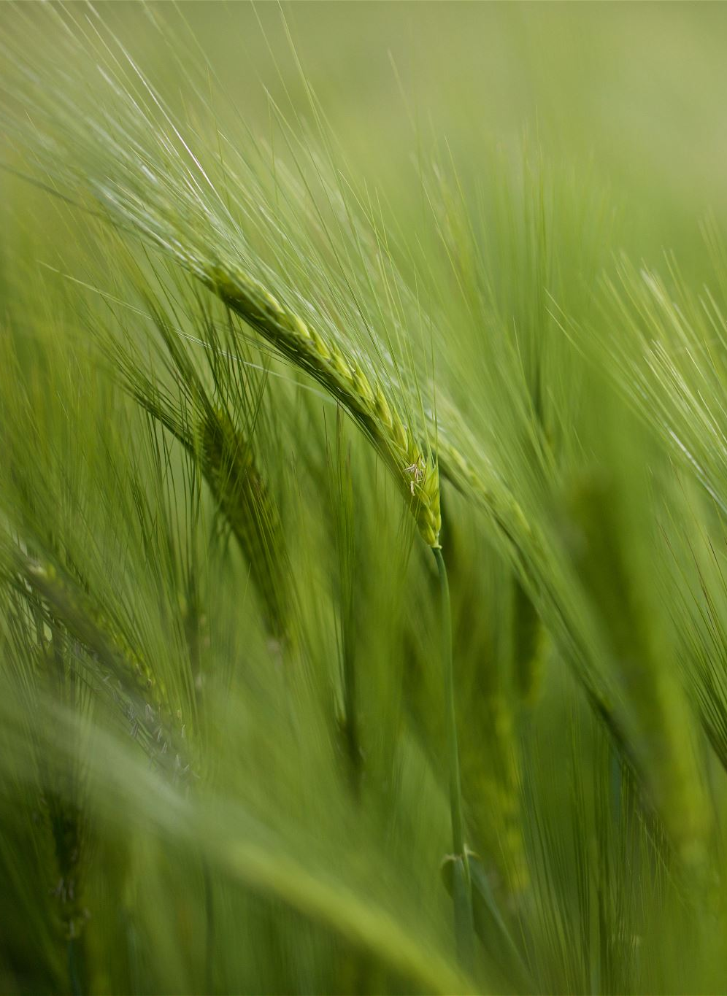
Ecosystem - Definition
Community of living organisms that interact with the non-living components within an environment.

Slide 13
How are environments classified?
Geographers categorise environments based on their combinations of geographic characteristics.
Land-based environments – climate, elevation, topography, vegetation and soil types.
Marine environments – water quality and depth.

Slide 14
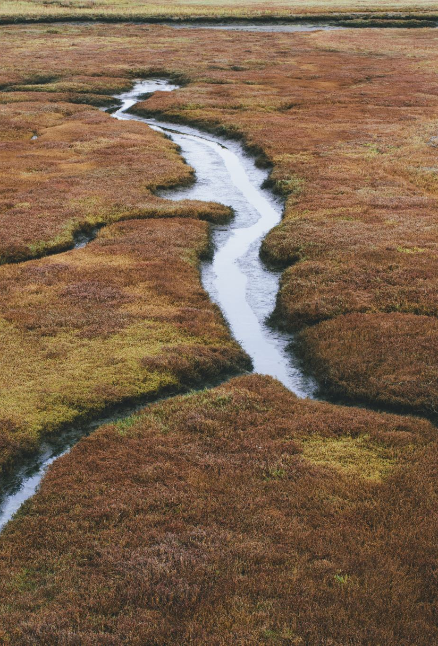
Types of environments
Land – deserts, forests
Land cover – the physical land type covering the Earth’s surface, including vegetation, water, ice and bare soil.
Inland water environments – wetlands
Coastal environments
Marine environments
Urban environments

Slide 15
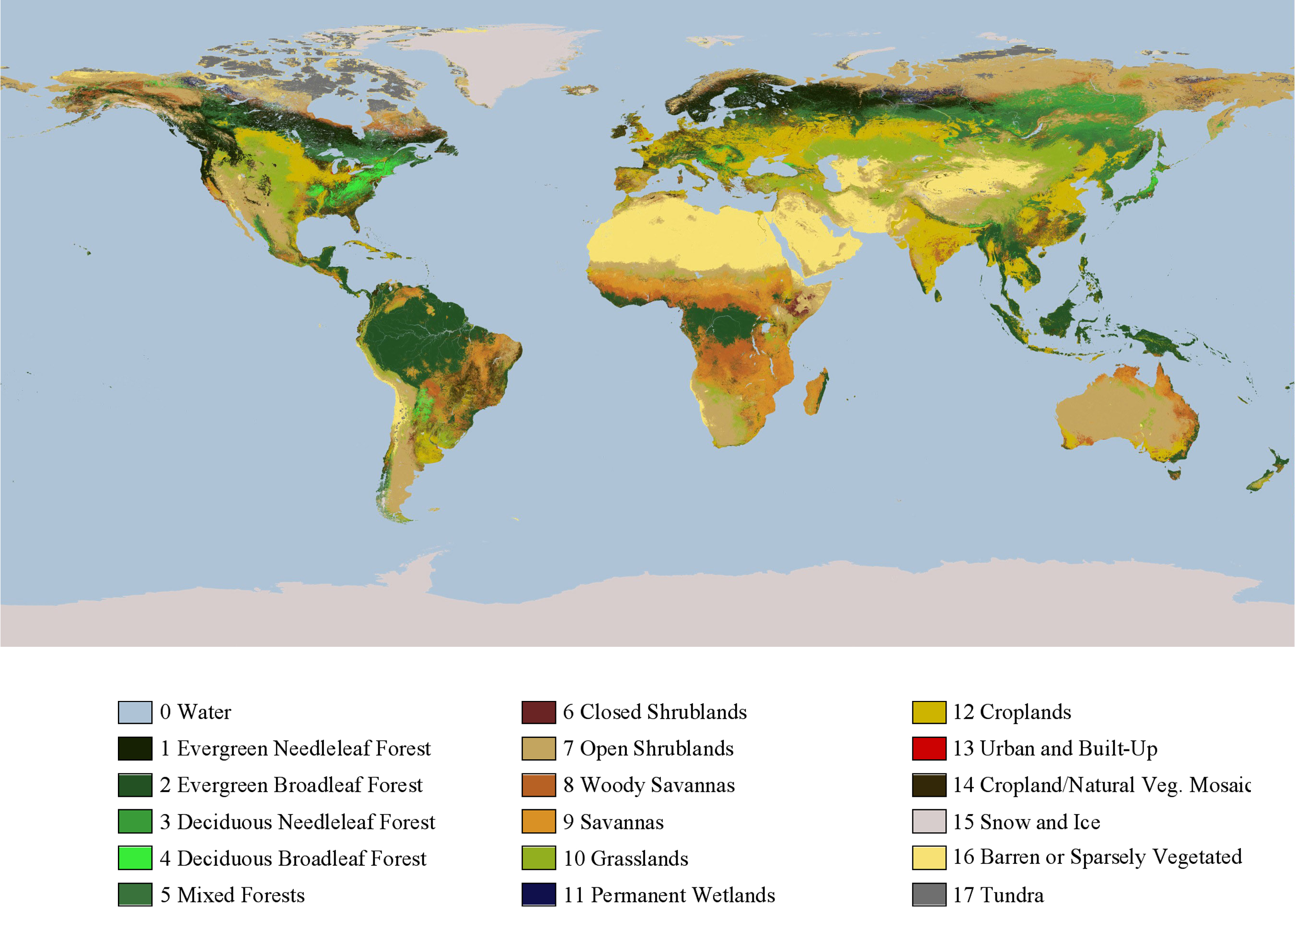

Slide 16
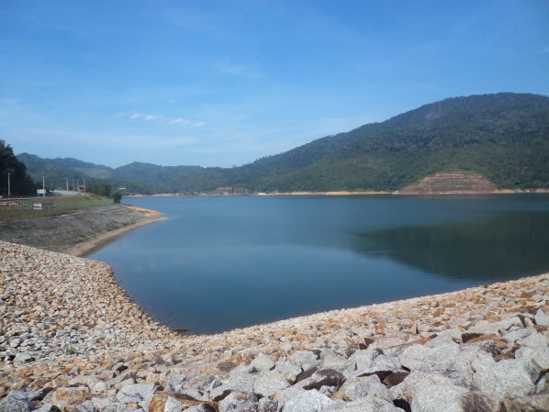
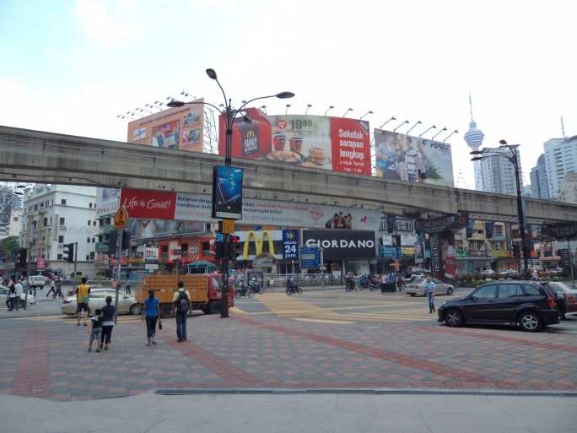
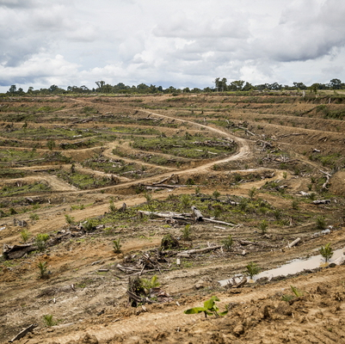
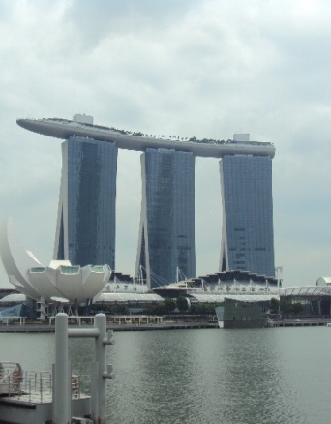
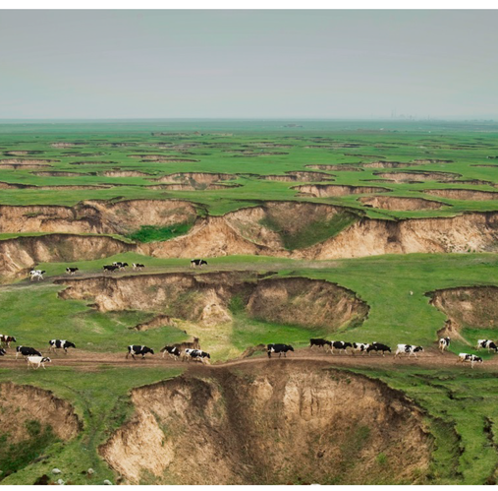
Processes of land cover change
Notes:
Image –Source: Greenpeace - Baorixile, Hulunbeir in Inner Mongolia. This grassland has subsided due to the lowering of the water table caused by coal mining.

Slide 17
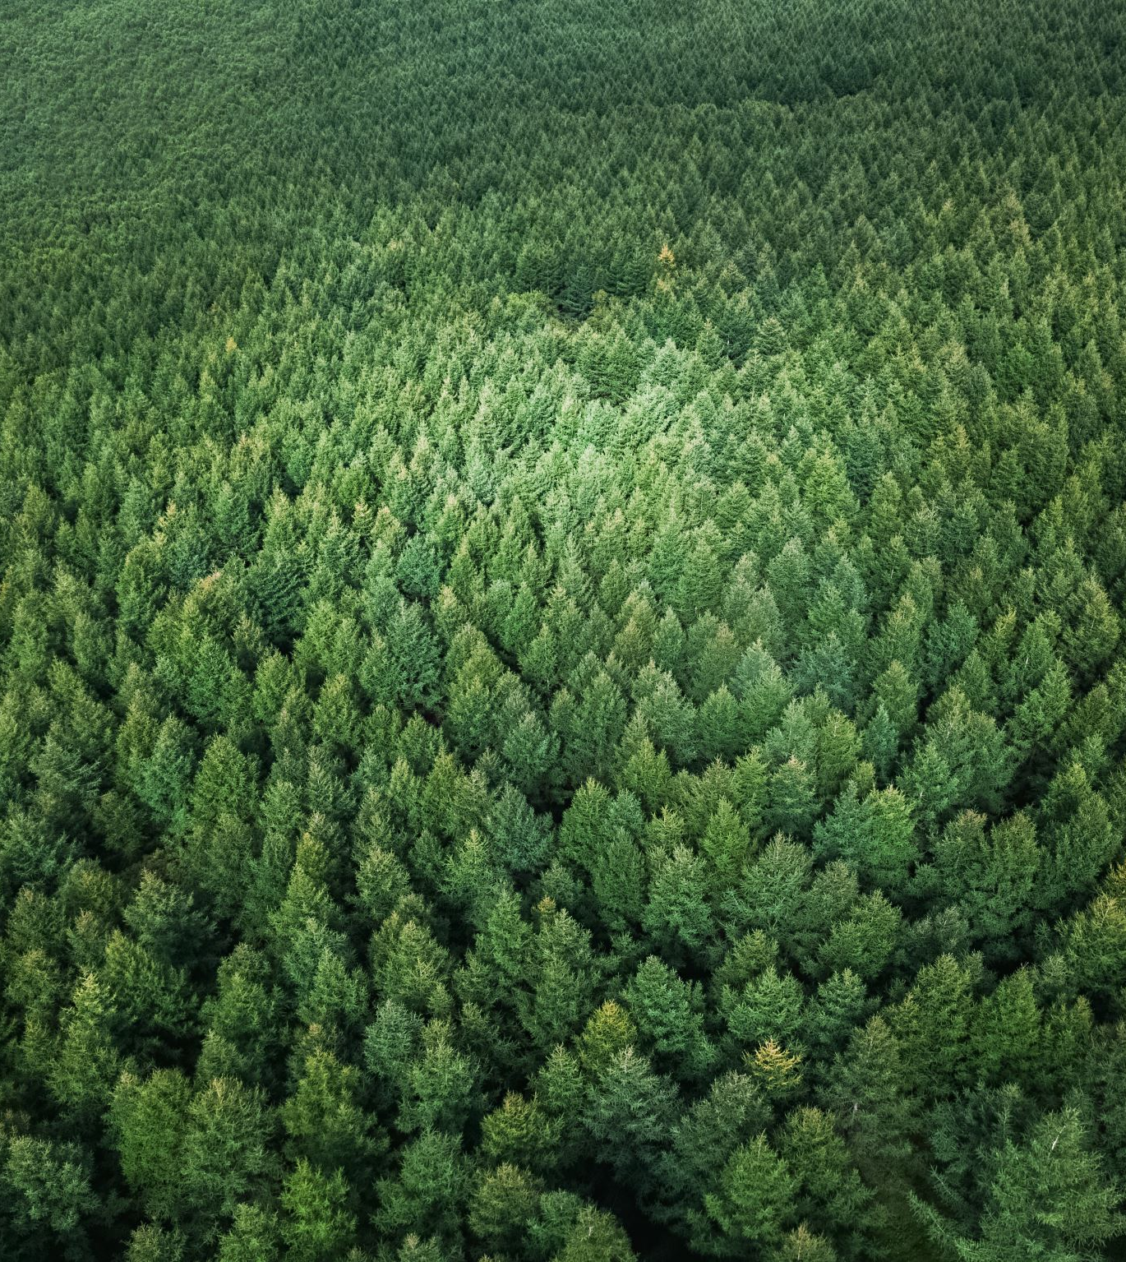
Deforestation
Deforestation is the removal or clearing of forests.
The forest land is converted to other uses e.g. agricultural land use.
The main drivers are;
agriculture, land-clearing for planting crops, or livestock.
Growing population and urban sprawl have forced further land clearing in urban/rural fringe areas.

Slide 18
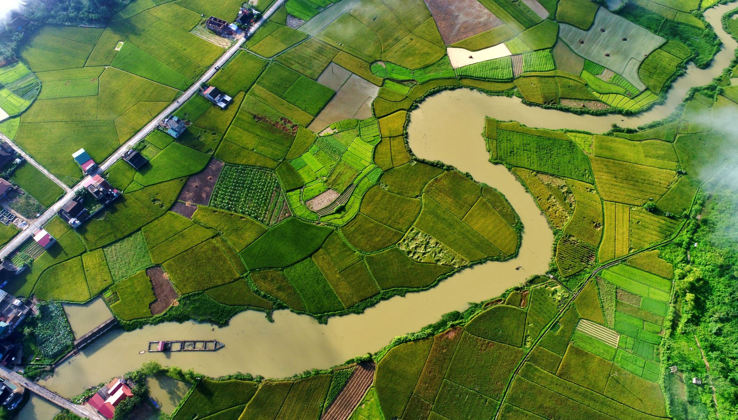
Expansion and intensification of agriculture
The world’s population is increasing at an average of 200, 000 people a day. This increasing population requires to be fed, so we have seen a trend of increasing land being used for agricultural.
Arable land per capita has decreased over the years as there is very little undeveloped farmland left. Much of the remaining land is either desert, ice or forest.

Slide 19

Land and soil degradation
Land degradation – the decline in the quality of natural land resources, commonly caused by improper use. It includes soil degradation
It includes the adverse effects of overgrazing, excessive tillage, erosion, sediment deposition, mining, urbanisation, disposal of industrial wastes, road construction, decline of plant communities and the effects of noxious plants and animals.
Desertification is a significant impact of soil degradation.

Slide 20
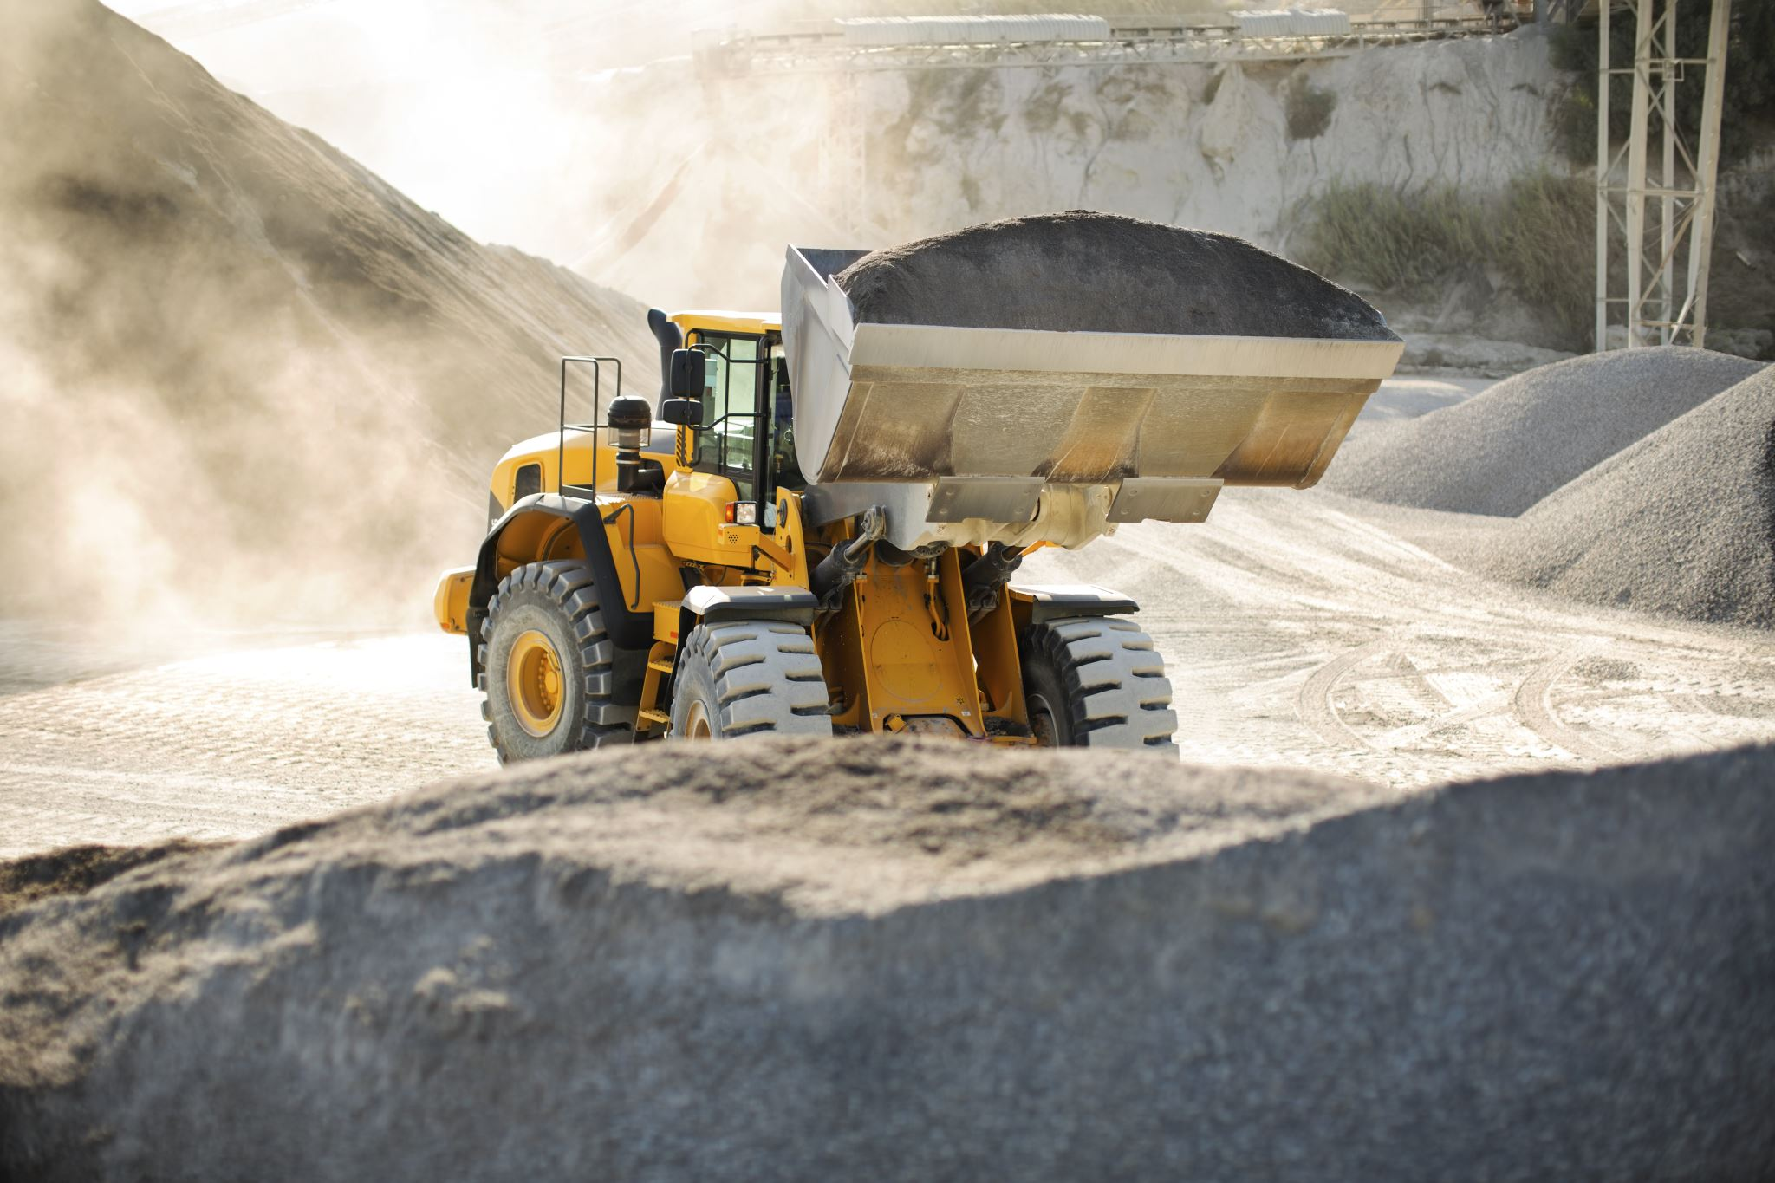
Mining
Mining is an important industry for many countries including Australia.
Australia is very regulated; however, many countries are not.
For example, illegal gold mining occurs in Venezuela which threatens their river systems due to the erosion caused through their mining practices and the fact that mercury (used in the processes to separate the gold) is washed down the river system. Large tracts of land have been cleared for these mines to be established and once they are finished, there is no rehabilitation of the land.

Slide 21
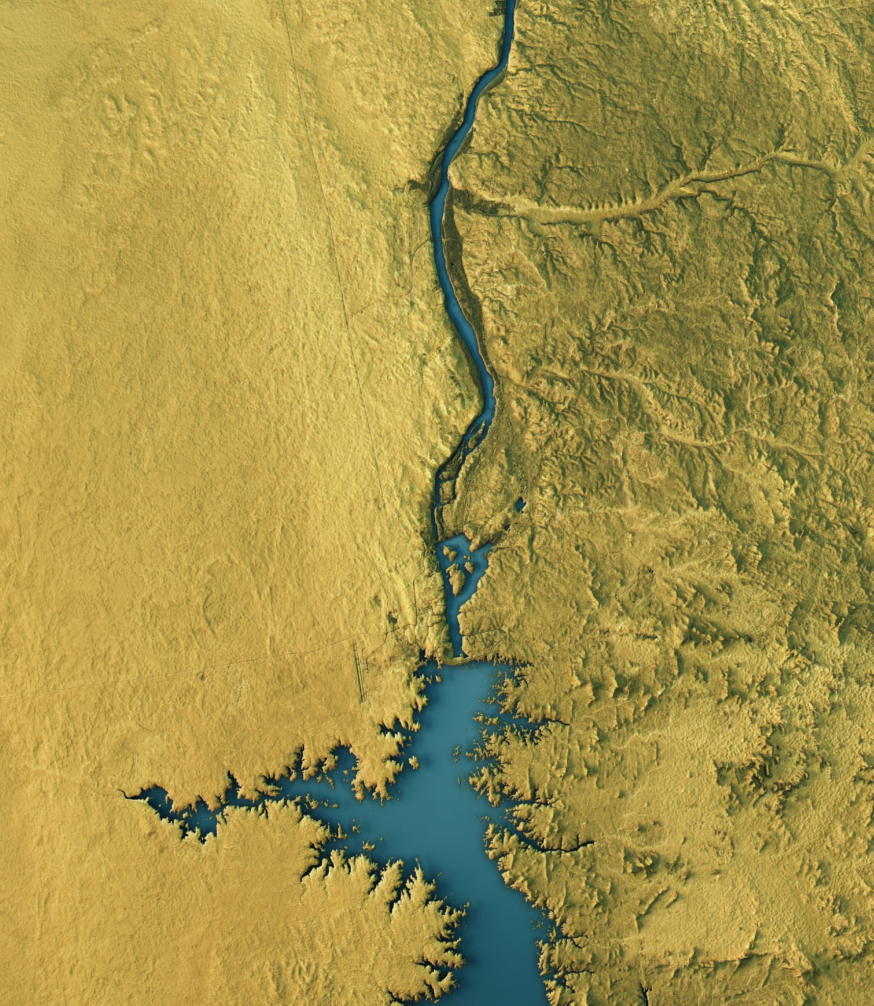
Land reclamation
Land reclamation, usually known as reclamation, is the process of creating new land from ocean, riverbeds, or lake beds.
Environmental impacts lead to loss of biodiversity as aquatic ecosystems become terrestrial.
Drainage of wetlands to turn into land interrupts ecosystems, leading to loss of biodiversity.

Slide 22
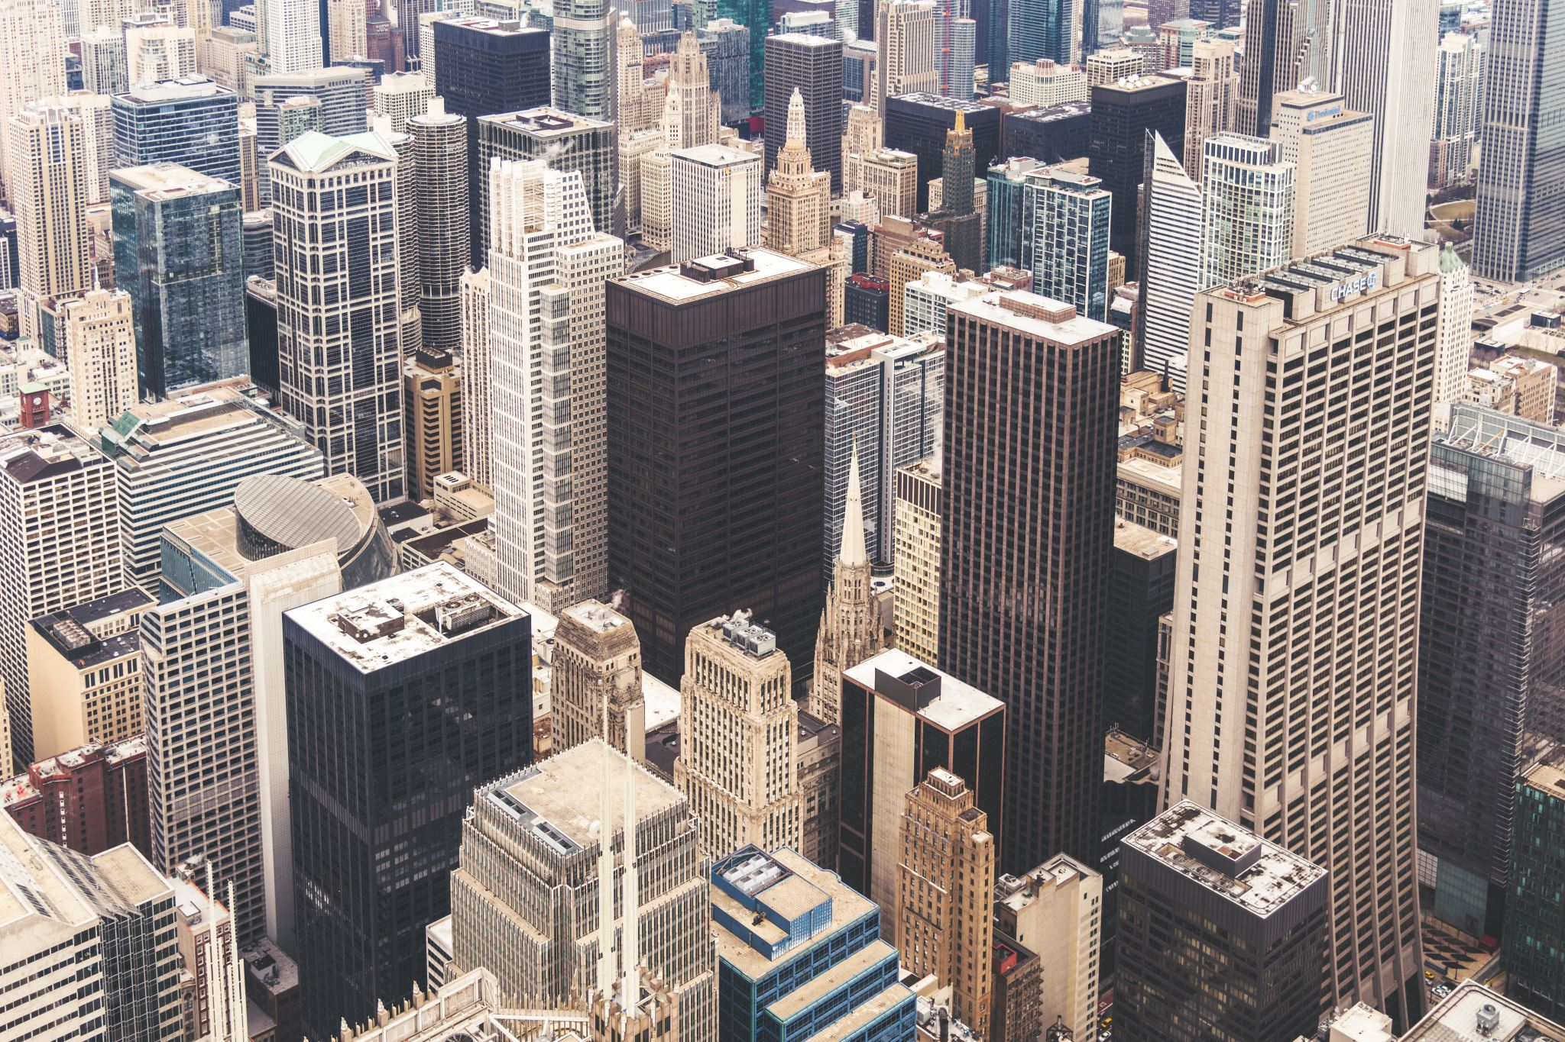
Growth of urban settlements
Urban growth has been occurring at an unprecedented rate over the last few decades. In 2008 the split between the rural and urban population of the world became even. There were 400 cities with a population over 1 million and 19 megacities.
Urbanisation is occurring quickly within developing countries. The need to sustain larger populations within urban areas, will put further pressure on the surrounding land.
The main causes for urban growth are: Push & Pull factors
Lack of employment opportunities in rural areas
Higher standard of living and job opportunities in urban areas.
Better medical conditions including successful births and longer life expectancy in urban areas.

Slide 23
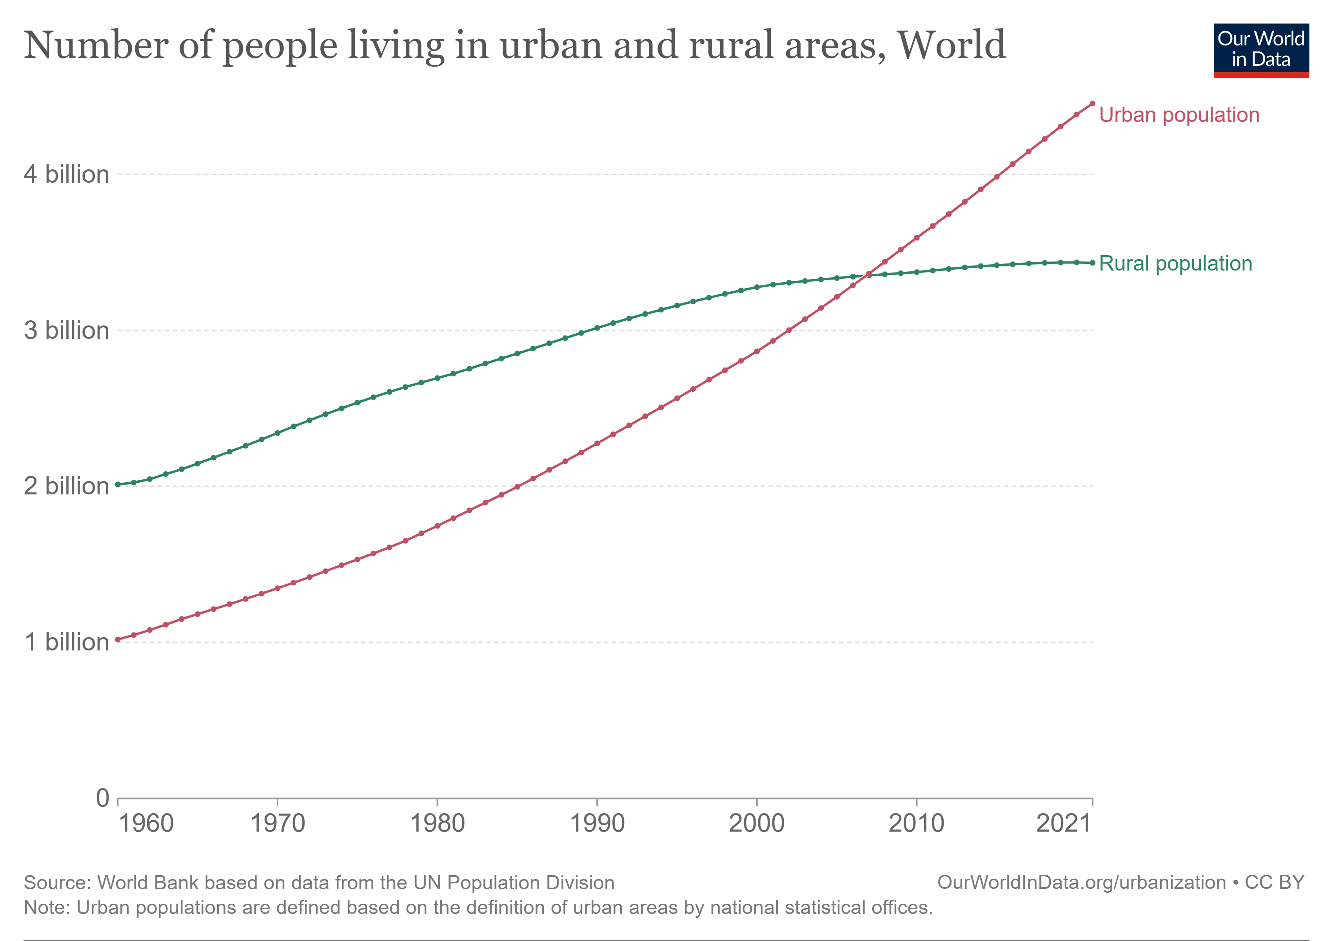

Slide 24
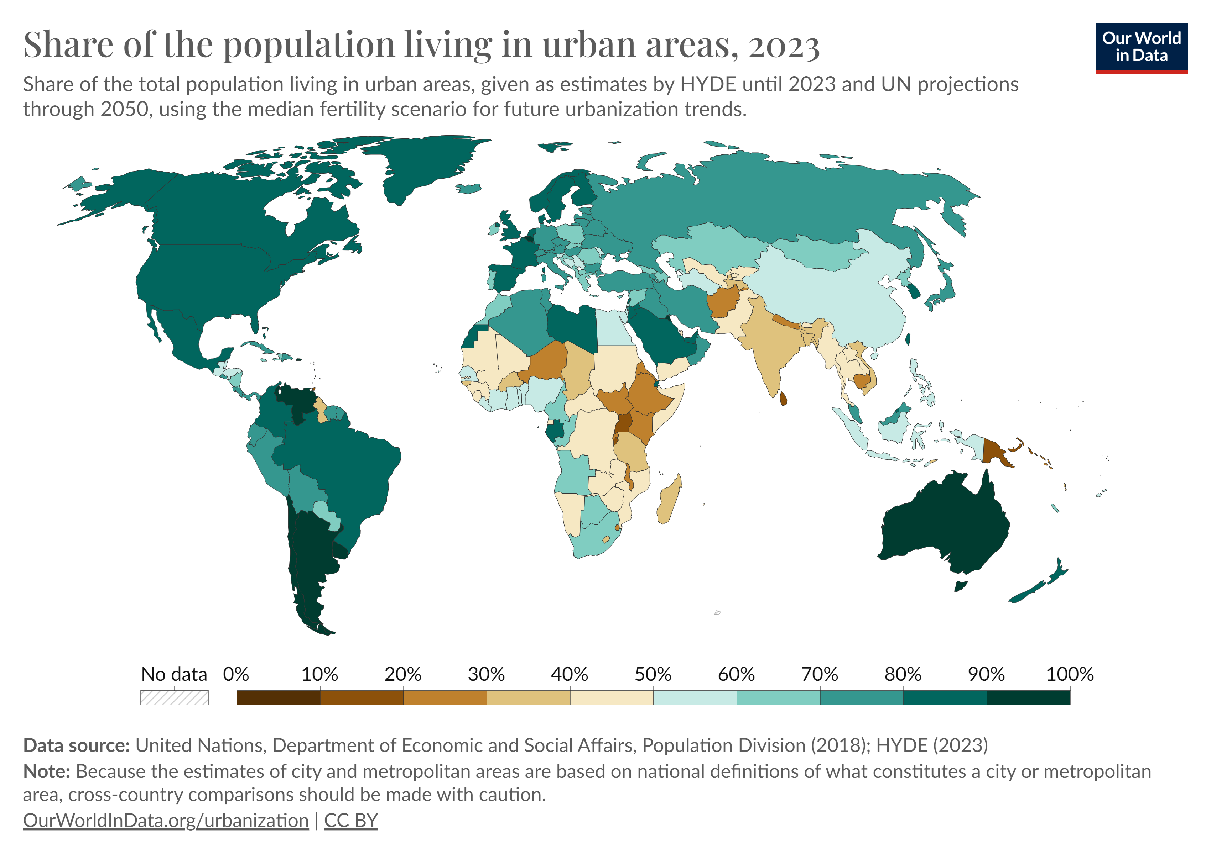

Slide 25
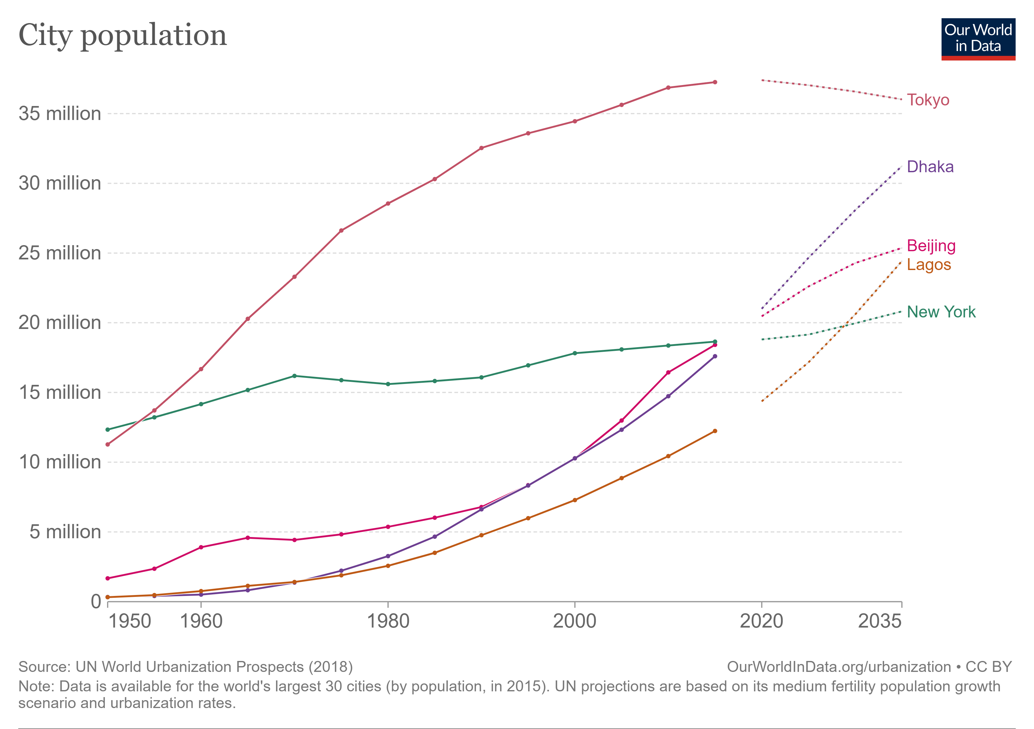

Slide 26
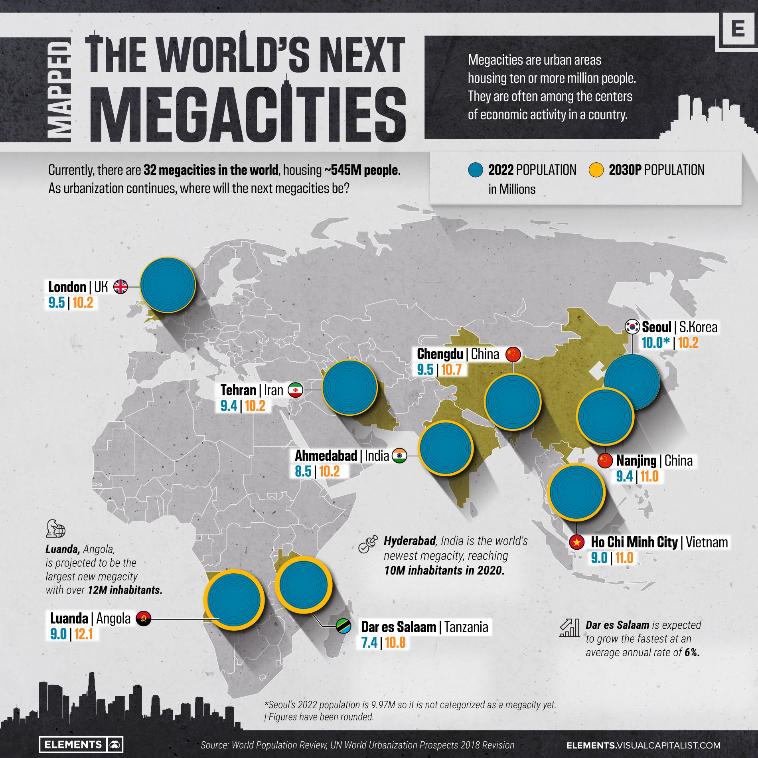

Slide 27
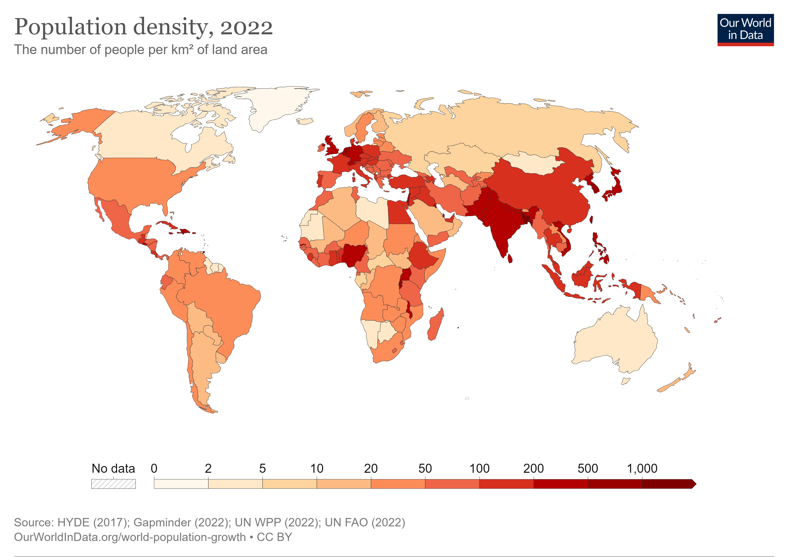

Slide 28
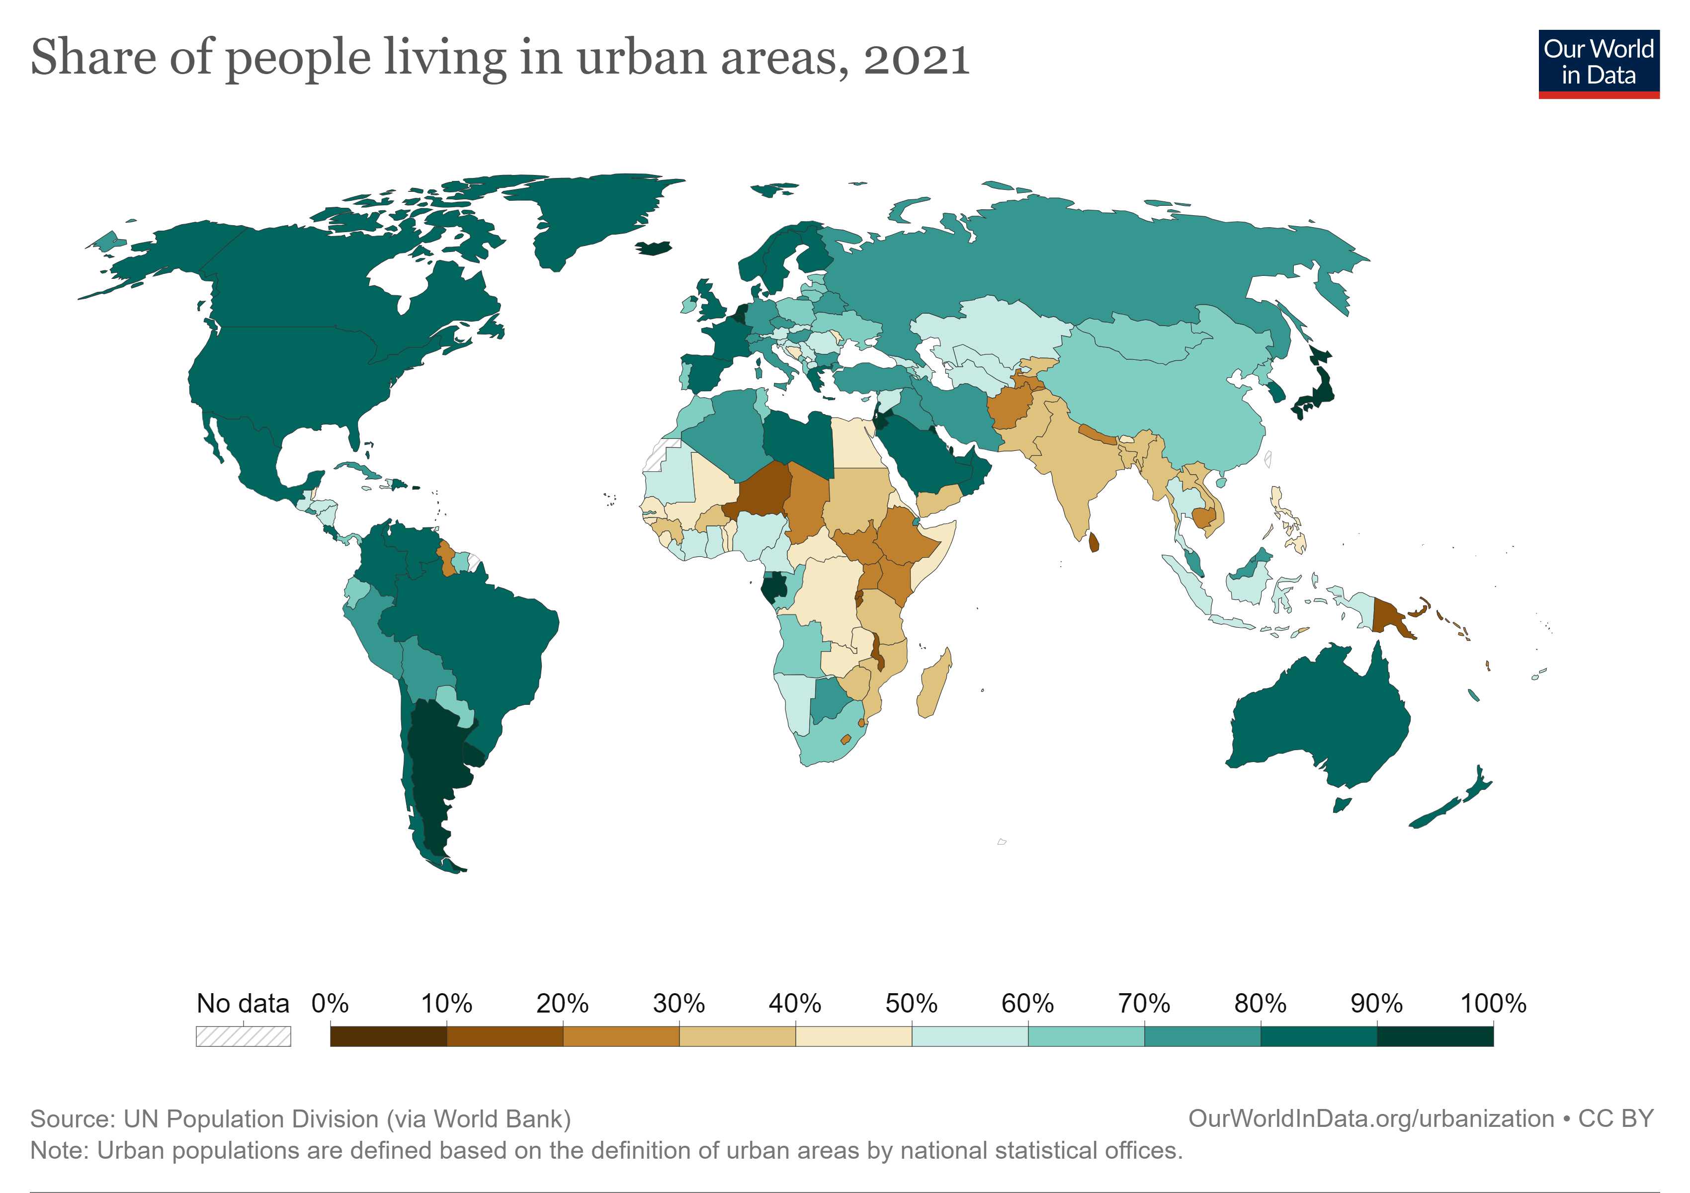

Slide 29
Choropleth Map
These types of maps use areal shapes or polygons to show spatial information.
Different shades of colour
The most common method of presentation is to use colours or shading based on the number of categories into which the data has been classified. The polygon is often based on an area for which statistical information is readily available, such as a suburb, local government area or a country

Slide 30
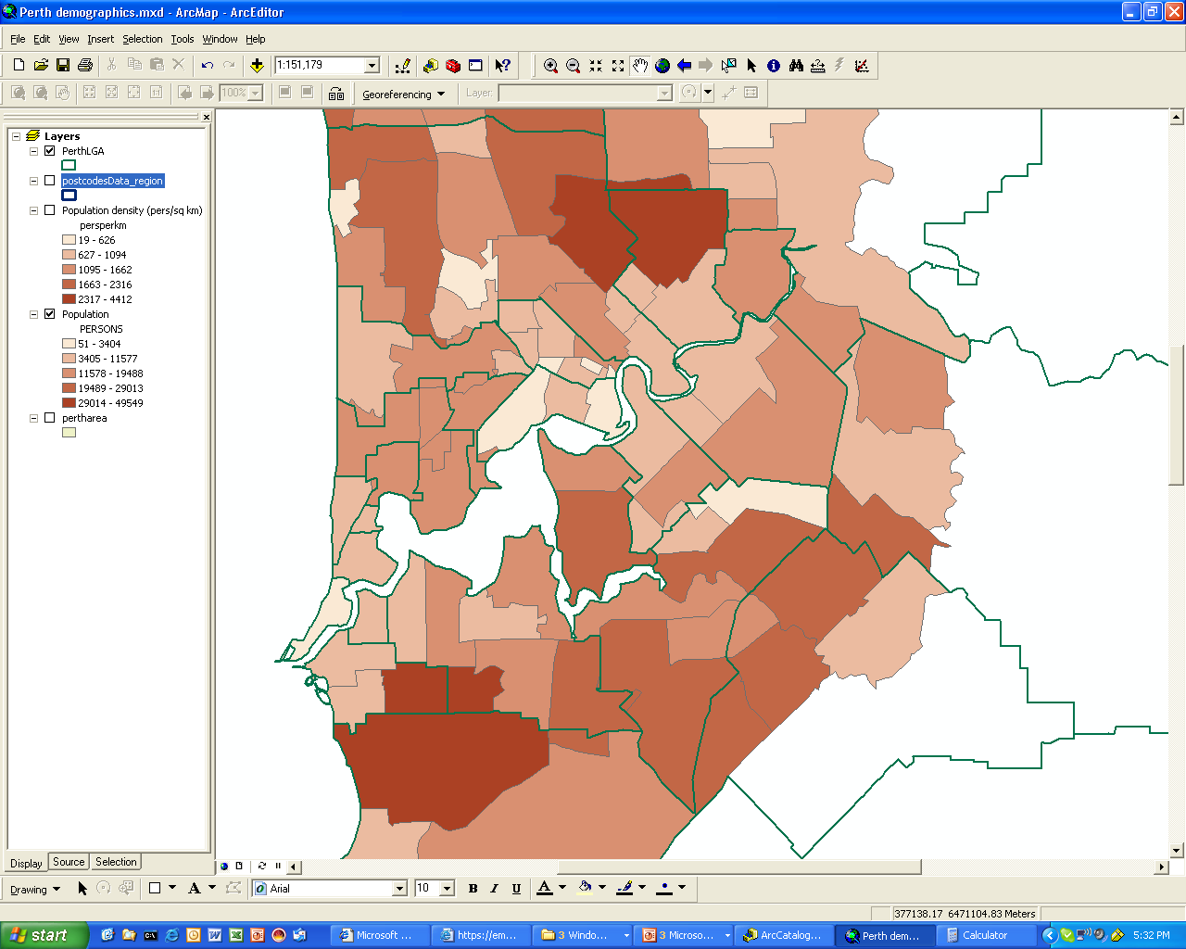
Choropleth map
This choropleth map shows the population number for local government areas of Perth

Slide 31
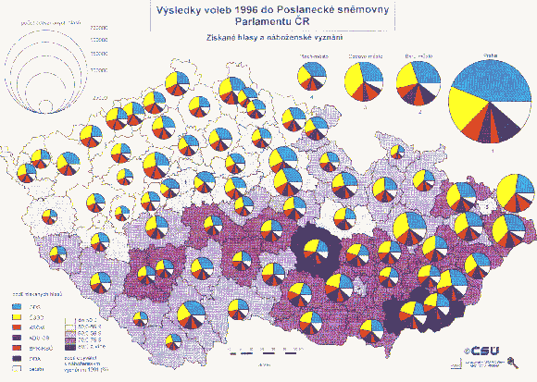
Proportional Symbol Maps
As the name implies, symbols (most often circles) are drawn proportional in size to the size of the variable (e.g. employment change) being represented. Proportional symbol maps are not dependent on the size of the area associated with the variable. In other words, on a proportional symbol map of Europe, tiny Liechtenstein would have the same visual importance as Spain if their unemployment values were the same. This is not the case with a choropleth map.
An example of proportional circles is shown on the Czech Republic Voting Register map

Slide 32
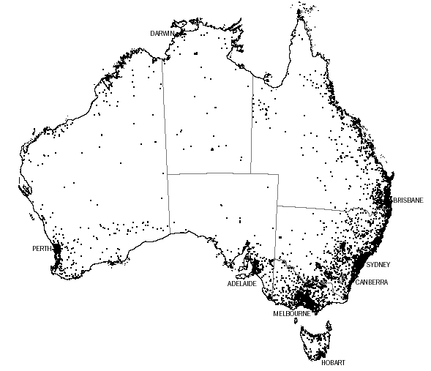
Dot Distribution Maps
A dot map uses a dot to represent the number of a phenomenon found within the boundaries of a geographic area. In addition, the cartographer usually attempts to show the pattern of distribution within the area by placing the dots where the phenomenon is most likely to occur.
Each dot = 1000 people

Slide 33
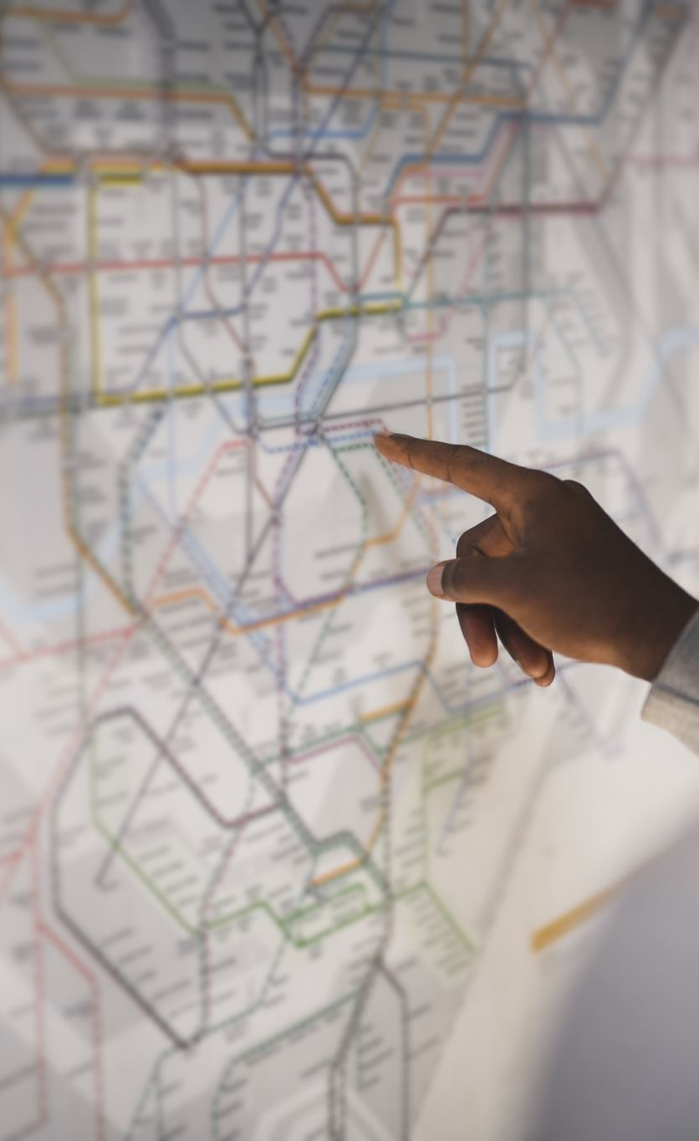
Sustainable Development Goals
https://sdgs.un.org/topics
Which topics relate to you now and in the future?

